Slide 1

VEL TECH HIGH TECH Dr. RANGARAJAN Dr. SAKUNTHALA ENGINEERING COLLEGE An Autonomous Institution
Department of Information Technology
MINI PROJECT - II
MEDBRIDGE CONNECTING NETWORKS FOR CRITICAL INSIGHTS
VASANTH.S (113022205112 )
SANTHOSH.T (113022205090)
SAKTHI NAGA SARVESH .A (113022205084)
III Year, INFORMATION TECHNOLOGY
Supervisor
Mrs. T. SEETHA LAKSHMI M.E(CSE)
ASSISTANT PROFESSOR

Slide 2
AGENDA
Abstract Objective Literature Survey Existing System Drawbacks of existing system Proposed System Block diagram Advantages of proposed work | 9. Software tool requirements 10. Algorithm 11. Model output 12. Conclusion 13. Future works 14. References

Slide 3
ABSTRACT
MedBridge is an innovative platform designed to facilitate real-time communication between hospitals and clinics, acting as an intermediary for the exchange of critical medicinal resources.
It collects and provides authorized data on the availability of essential resources such as blood, organ and bone. By streamlining the sharing of information, MedBridge enables healthcare institutions to respond more effectively to urgent medical needs, optimize resource usage, and ensure that life-saving materials are accessible when and where they are most needed.
The platform fosters a collaborative network of hospitals and clinics, improving healthcare outcomes through efficient resource management and transparent communication.

Slide 4
OBJECTIVE
Build a platform to connect healthcare professionals and organizations for seamless collaboration.
Facilitate the exchange of critical insights to improve decision-making in healthcare.
Promote innovation and better patient outcomes through effective networking and shared expertise.

Slide 5
LITERATURE SURVEY
S.NO | YEAR | TITLE | AUTHOR | ADVANTAGE | DRAWBACK
1 | 2022 | Assured Data Communications as a Service for Internet of Medical Things | Ventsislav Trifonov | A reliable donation system during COVID-19 ensured accessibility, efficient distribution, and trust. | Developing reliable donation systems during COVID-19 faced challenges like the digital divide
2 | 2021 | Optimal Deployment in Emergency Medicine with Genetic Algorithm Exemplified by Lifeguard Assignments | Jonas Chromik and Bert Arnrich | Genetic algorithms optimize lifeguard deployment, enhancing response speed, adaptability, and safety while reducing costs and errors. | Genetic algorithms can be complex, resource-intensive, and may struggle with real-time

Slide 6
LITERATURE SURVEY
S.NO | YEAR | TITLE | AUTHOR | ADVANTAGE | DRAWBACK
3 | 2022 | Enabling Precision Medicine via Contemporary and Future Communication Technologies | Barbara Kowal , Robert Ranosz , Michał Kłodawski, Roland Jachimowski , and Janusz Piechna | Hyperloop speeds up travel, cuts congestion, supports sustainability, drives economic growth, and enhances connectivity. | Relevant scientific articles, categorizes them, and provides an Overview of their development over time.
4 | 2022 | A Machine Learning Enabled Near Infrared Tracking Scheme for Localization of Gastrointestinal Smart Capsul | HONGJIE JIANG , JIANCONG YE, CHAOFAN LING, AND JUNPEI ZHONG | Machine learning enhances NIR tracking of gastrointestinal smart capsules by improving accuracy,and cost-effectiveness | Achieves "super-linear acceleration" compared to single-core fuzzing.

Slide 7
LITERATURE SURVEY
S.NO | YEAR | TITLE | AUTHOR | ADVANTAGE | DRAWBACK
5 | 2022 | Towards Micropump- and Microneedle-based Drug Delivery using Micro Transdermal Interface Platforms (MicroTIPs) | Fjodors Tjulkins, Ryan Sebastian, Theo Guillerm, A. James P. Clover, Yuan Hu, Alexander Lyness and Conor O’Mahony. | MicroTIPs provide a minimally invasive, controlled, and efficient drug delivery method. | Micropump- and microneedle-based systems can be complex and costly to manufacture.

Slide 8
EXISTING SYSTEM
Existing networks often restrict the seamless exchange of patient data and insights due to interoperability issues and data privacy concerns.
Collaboration between institutions, professionals, and stakeholders is not centralized, leading to delays in critical insights and innovations.
Many processes, such as data aggregation and sharing, are still manual, leading to inefficiencies and a higher risk of errors.

Slide 9
DRAWBACKS FOR EXISTING SYSTEM
Incompatibility between platforms and inadequate security measures hinder seamless data exchange and pose risks to patient privacy.
Manual processes and limited real-time insights result in slower decision-making, adversely affecting patient outcomes and healthcare efficiency.
Existing systems lack integration, making it difficult for healthcare professionals to access and share information efficiently in real time.

Slide 10
PROPOSED SYSTEM
Implement a system that enables interoperability between various healthcare platforms, ensuring secure and efficient sharing of patient data and insights.
Establish a unified platform for institutions, professionals, and stakeholders to collaborate on research, case studies, and innovative healthcare solutions.
Automate data aggregation and sharing processes to reduce manual effort, minimize errors, and improve overall efficiency in healthcare operations.

Slide 11
ADVANTAGES FOR PROPOSED WORK
Real-Time Collaboration : Enables healthcare professionals to communicate and share insights instantly, improving coordination and reducing response times.
Seamless Data Interoperability : Reducing the wastage of valuable medications by facilitating the donation of unused medicines.
Improved Efficiency and Automation : The platform enhances healthcare access for low-income individuals by providing access to essential medicines that are not affordable.
Better Patient Outcomes : The redistribution of unused medicines benefits both donors and recipients by reducing healthcare costs.
The system can significantly enhance public health and environmental conservation by effectively utilizing surplus medications.

Slide 12
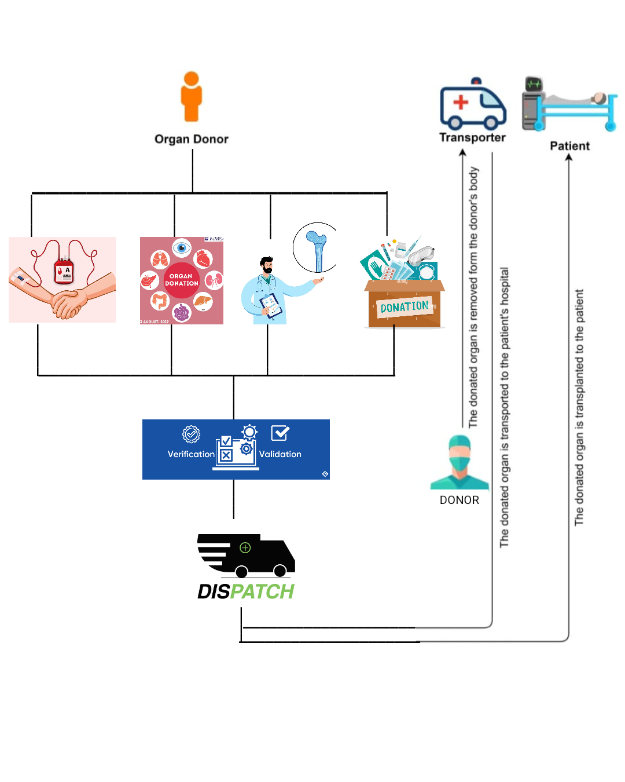
PROPOSED WORK-FLOW BLOCK DIAGRAM
HOSPITAL A
HOSPITAL B

Slide 13
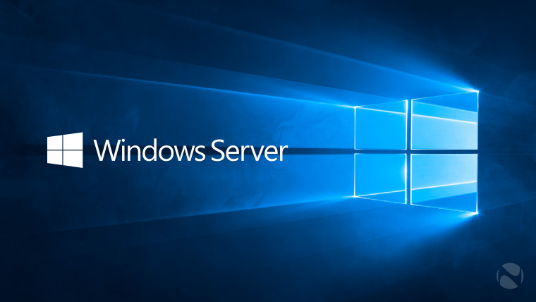

SOFTWARE TOOL REQUIREMENTS
WEB BROWSER :
Chrome
Microsoft Edge
Firefox
WINDOWS / LINUX

Slide 14
ALGORITHM
Cloud Storage and Computing Services :
Enables scalable and secure storage for large volumes of healthcare data.
Big Data Analytics :
Combines data from multiple sources to generate actionable insights.
Validity and Verification :
Used to check the given data is valid and also verify its truthness.
Security Enhancement :
It have allow the administrative login for security purpose and secure environment.

Slide 15
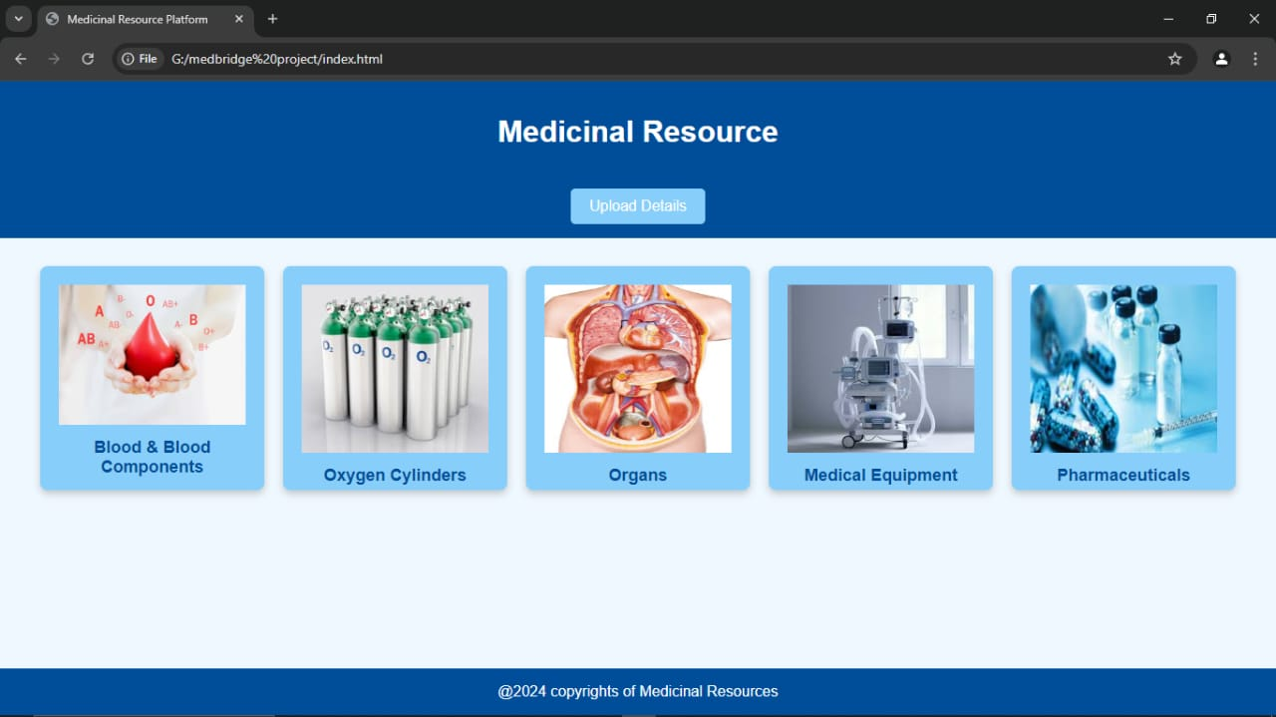
Sample output

Slide 16
CONCLUSION
The system provides a unified platform for seamless communication and data sharing, ensuring security and efficiency.
MedBridge stands as a transformative solution, bridging gaps and empowering the healthcare ecosystem to deliver better care with precision and speed.
It also Enhance the safety and provide the user friendly environment.

Slide 17
FUTURE WORK
Progressive Web Apps (PWAs)
Voice User Interfaces (VUIs)
Accessibility and Inclusive Design
Blockchain and Web3 Development
Data Visualization and Infographics

Slide 18
REFERENCES
McGregor, M. (2019). Impact of Medicine Redistribution Programs on Public Health. Journal of Pharmaceutical Health Services Research, 10(2), 123-130.
Smith, R., & Jones, L. (2021). Reducing Pharmaceutical Waste Through Donation Programs: A Review. International Journal of Environmental Research and Public Health, 18(4), 567-576.
Williams, T., & Brown, K. (2020). Evaluating the Effectiveness of Medicine Donation Programs. Journal of Medical Economics, 23(1), 45-55.
Lee, C. (2018). The Role of Technology in Medicine Donation and Redistribution. Health Information Science and Systems, 6(1), 29-38.
Thompson, P., & Patel, S. (2019). Pharmaceutical Waste Management: Case Studies and Solutions. Waste Management & Research, 37(5), 487-494.

Slide 19
THANK YOU

